Slide 1
Transactions
Chp 14, Database Systems, Korth , 6th edition

Slide 2
What is a transaction?
Transactions
Collections of operations that form a single logical unit of work are called transactions.
A transaction is a unit of program execution that accesses and possibly updates various data items.
Initiated by SQL or C++ or Java with embedded database accesses in JDBC or ODBC.
Begin transaction
transaction operations
End transaction
This collection of steps must appear to the user as a single, indivisible unit
Sudha Bhagavatheeswaran, Department of Information Technology,
SIES College of Arts, Science & Commerce (Autonomous)

Slide 3
ACID properties of a Transaction
Transactions
Atomicity :- Either all operations of the transaction are reflected properly in the database, or none are.
Consistency :- Execution of a transaction in isolation (that is, with no other transaction executing concurrently) preserves the consistency of the database.
Isolation :- Even though multiple transactions may execute concurrently, the system guarantees that, for every pair of transactions Ti and Tj , it appears to Ti that either Tj finished execution before Ti started or Tj started execution after Ti finished. Thus, each transaction is unaware of other transactions executing concurrently in the system.
Durability. :- After a transaction completes successfully, the changes it has made to the database persist, even if there are system failures.
Sudha Bhagavatheeswaran, Department of Information Technology,
SIES College of Arts, Science & Commerce (Autonomous)

Slide 4
Ensuring ACID properties
Transactions
Ensuring consistency for an individual transaction is the responsibility of the application programmer who codes the transaction.
Ensuring atomicity is the responsibility of a component of the database called the recovery system
Ensuring durability is the responsibility of a component of the database called the recovery system
Ensuring the isolation property is the responsibility of a component of the database system called the concurrency-control system
Sudha Bhagavatheeswaran, Department of Information Technology,
SIES College of Arts, Science & Commerce (Autonomous)

Slide 5
A Simple Transaction Model
Transactions
A simple bank application consisting of several accounts and a set of transactions that access and update those accounts.
Transactions access data using two operations:
  read(X), which transfers the data item X from the database to a variable.
  write(X), which transfers the value in the variable X in the main-memory buffer of the transaction that executed the write to the data item X in the database.
Sudha Bhagavatheeswaran, Department of Information Technology,
SIES College of Arts, Science & Commerce (Autonomous)

Slide 6
A Simple Transaction Model
Transactions
Let Ti be a transaction that transfers $50 from account A to account B. This transaction can be defined as:
  Ti : read(A);
  A := A − 50;
  write(A);
  read(B);
  B := B + 50;
  write(B).
Sudha Bhagavatheeswaran, Department of Information Technology,
SIES College of Arts, Science & Commerce (Autonomous)

Slide 7
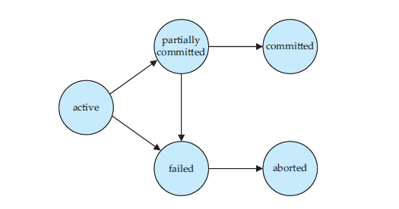
Transaction Model - states
Transactions
Sudha Bhagavatheeswaran, Department of Information Technology,
SIES College of Arts, Science & Commerce (Autonomous)

Slide 8
Transaction Model - states
Transactions
Active, the initial state; the transaction stays in this state while it is executing.
Partially committed, after the final statement has been executed.
Failed, after the discovery that normal execution can no longer proceed.
Aborted, after the transaction has been rolled back and the database has been restored to its state prior to the start of the transaction.
Committed, after successful completion.
A transaction is said to have terminated if it has either committed or aborted.
Sudha Bhagavatheeswaran, Department of Information Technology,
SIES College of Arts, Science & Commerce (Autonomous)

Slide 9
Example
Transactions
Transaction T1 transfers $50 from account A to account B.
T1: read(A);
A := A − 50;
write(A);
read(B);
B := B + 50;
write(B).
Transaction T2 transfers 10 percent of the balance from account A to account B.
T2: read(A);
temp := A * 0.1;
A := A − temp;
write(A);
read(B);
B := B + temp;
write(B).
current values of accounts A and B are $1000 and $2000
Sudha Bhagavatheeswaran, Department of Information Technology,
SIES College of Arts, Science & Commerce (Autonomous)

Slide 10
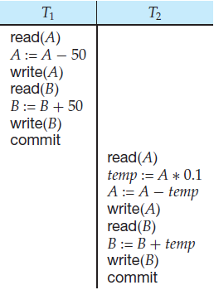
Schedule 1 - T1 is followed by T2.
Transactions
The final values of accounts A and B, after the execution takes place, are $855 and $2145, respectively.
The sum A + B is preserved
1000
950
2000
2050
950
A= 950 B= 2050
95
855
2050
2145
A= 855 B= 2145
Sudha Bhagavatheeswaran, Department of Information Technology,
SIES College of Arts, Science & Commerce (Autonomous)

Slide 11
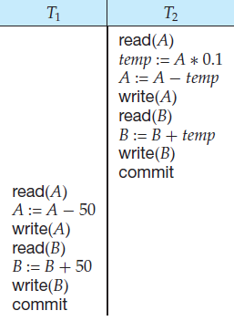
Schedule 2 - T2 is followed by T1.
Transactions
1000
100
The final values of accounts A and B
are $850 and $2150, respectively.
The sum A + B is preserved
900
2000
2100
900
A= 900 B= 2100
850
2100
2150
A= 850 B= 2150
Sudha Bhagavatheeswaran, Department of Information Technology,
SIES College of Arts, Science & Commerce (Autonomous)

Slide 12
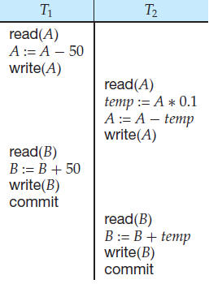
Schedule 3—a concurrent schedule
Transactions
The final values of accounts A and B, after the execution takes place, are $855 and $2145, respectively.
The sum A + B is preserved
1000
950
950
95
855
2000
2050
A= 855 B= 2050
2050
95
2145
A= 855 B= 2145
Sudha Bhagavatheeswaran, Department of Information Technology,
SIES College of Arts, Science & Commerce (Autonomous)

Slide 13
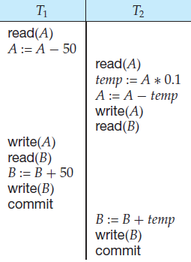
Schedule 4—a concurrent schedule (inconsistent state)
Transactions
1000
950
The final values of accounts A and B are $950 and $2100, respectively.
(inconsistent state) - the sum A + B is not preserved
1000
100
900
2000
950
2000
2050
2100
A= 950 B= 2050
2100
A= 950 B= 2100
Sudha Bhagavatheeswaran, Department of Information Technology,
SIES College of Arts, Science & Commerce (Autonomous)

Slide 14
Schedules
Transactions
The execution sequences are called schedules.
They represent the chronological order in which instructions are executed in the system.
Clearly, a schedule for a set of transactions must consist of all instructions of those transactions, and must preserve the order in which the instructions appear in each individual transaction.
A schedule is the order in which the operations of multiple transactions appear for execution.
Serial schedules are always consistent and Non-serial schedules are not always consistent.
Sudha Bhagavatheeswaran, Department of Information Technology,
SIES College of Arts, Science & Commerce (Autonomous)

Slide 15
Serial Schedules
Transactions
In serial schedules,
  All the transactions execute serially one after the other.
  When one transaction executes, no other transaction is allowed to execute.
Schedule 1 and 2 are serial schedules. Both are consistent.
Each serial schedule consists of a sequence of instructions from various transactions, where the instructions belonging to one single transaction appear together in that schedule
Sudha Bhagavatheeswaran, Department of Information Technology,
SIES College of Arts, Science & Commerce (Autonomous)

Slide 16
Non- Serial Schedules
Transactions
In non-serial schedules,
  Multiple transactions execute concurrently.
  Operations of all the transactions are inter leaved or mixed with each other.
Schedule 3 and 4 are non-serial schedules
Schedule 3 is consistent
Schedule 4 is not consistent
Therefore, non-serial schedules are not always consistent
Sudha Bhagavatheeswaran, Department of Information Technology,
SIES College of Arts, Science & Commerce (Autonomous)

Slide 17
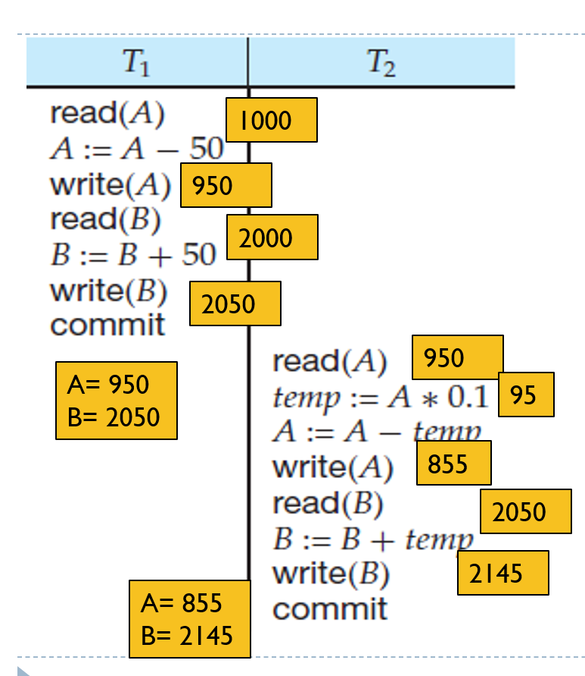
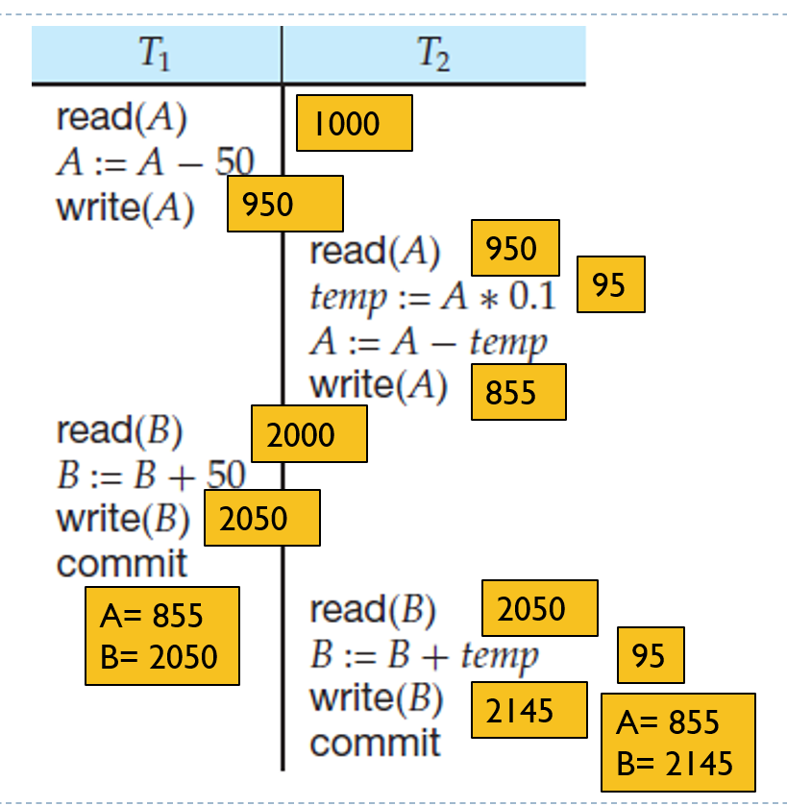
Schedule1 Schedule 3
Transactions
Sudha Bhagavatheeswaran, Department of Information Technology,
SIES College of Arts, Science & Commerce (Autonomous)

